Slide 1
Minor project presentation

Slide 2
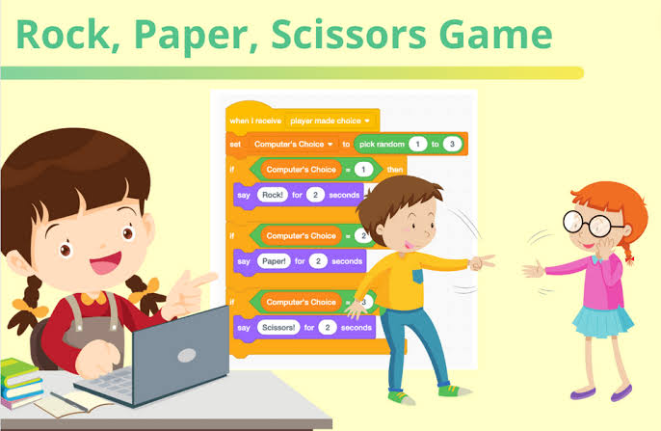
Rock paper scissor
Presented by
Ishu Sahu
Harshit Pandey

Slide 3
introduction
Rock paper scissor is a hand game which is usually played between two people.
In this game each player simultaneously forms one of three shapes with their hand.
These shapes are “Rock” , “Paper” and “Scissors”.

Slide 4
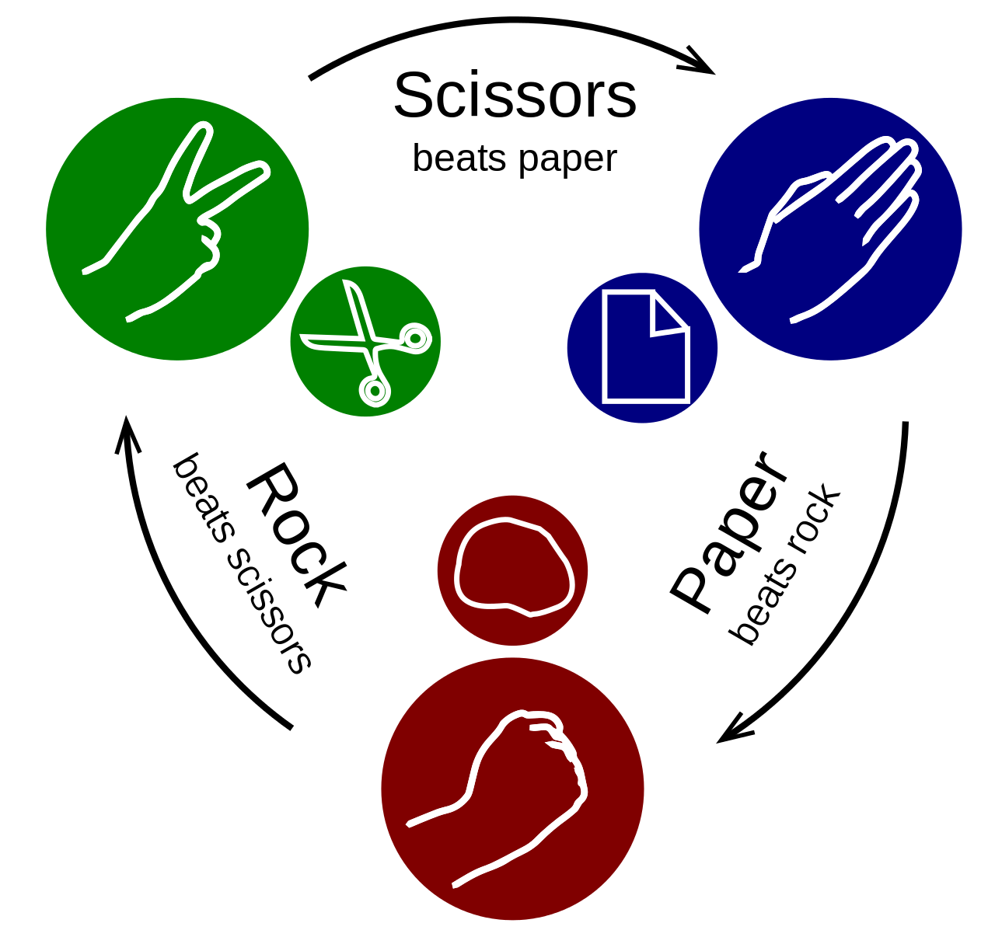

Slide 5
Software and hardware requirement
Software : For design of website of Rock paper Scissor we used
HTML
CSS
Javascript
And also used Visual studio as a software/Application.

Slide 6
HARDWARE
Hardware requirements are the things that we need to run and implement the project.
These requirements are computer, keyboard etc.

Slide 7
LIMITATIONS
Limitation of this game are :
Single player can play the game at a time
User can play the game single time and if
he/she wants to play the game again
he/she just need to restart the game.

Slide 8
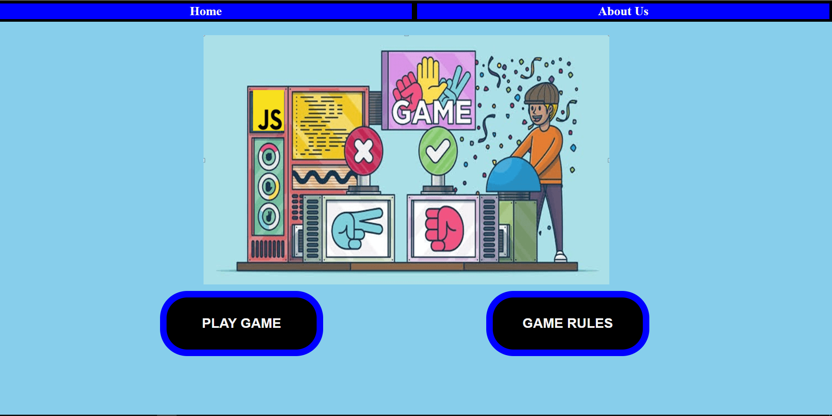
Preview of project

Slide 9
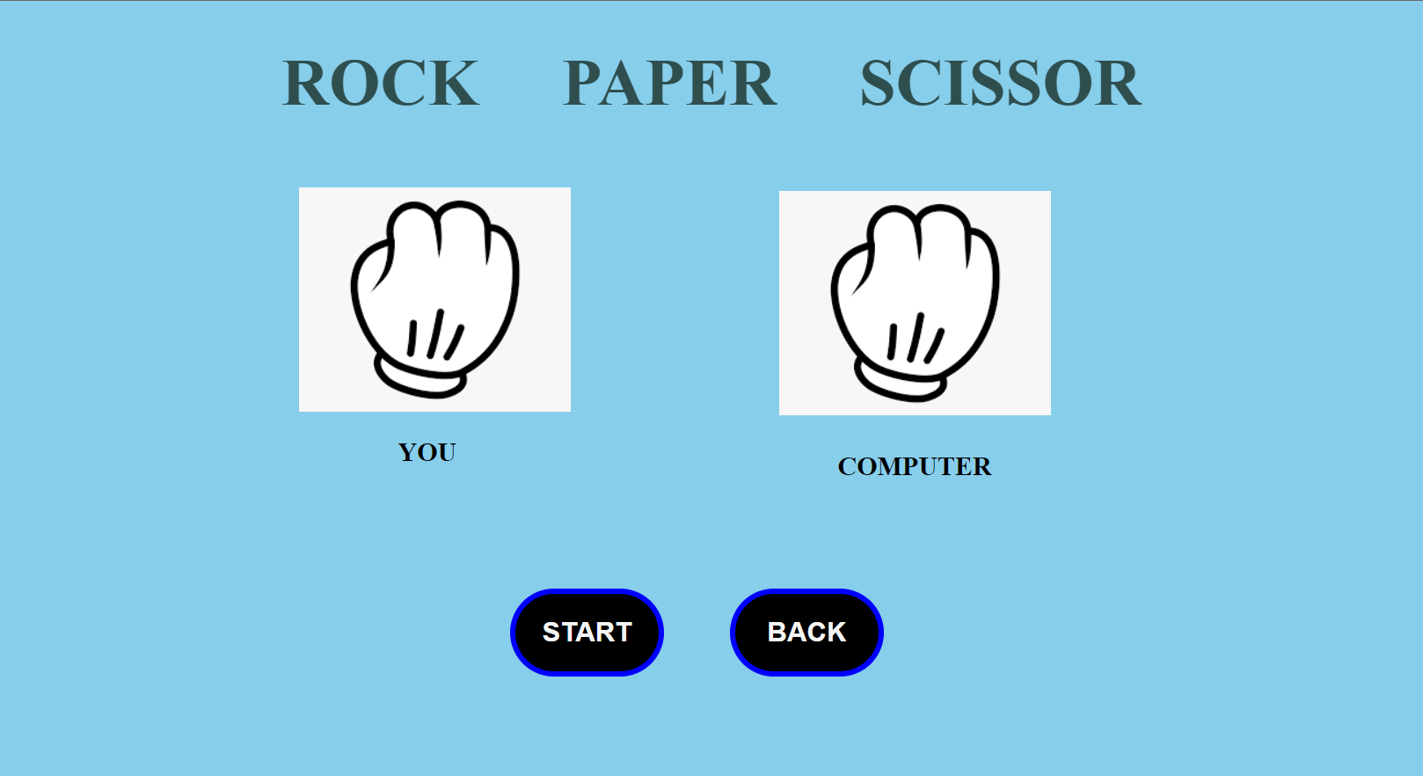

Slide 10
CONCLUSION
It just a small step of us that will help to show that how we can play our traditional games with computers in these modern age.

